Slide 1
Smurfing IRL

Slide 2
What is Smurfing?
Smurfing is when a high ranking player in a competitive game throws games to lower their rank, or plays on an alternate account with a lower rank.
They are then matched with players that are much less skilled so they can absolutely TRASH them.

Slide 3
Skill Ceiling, Skill Gap / Diff
Skill Ceiling is the range difference between having no skill, and being the best in the world
CSGO players are better at Valorant than Valorant players are at CSGO, because CSGO has a higher skill ceiling
CSGO is concentrated on aim and other skills that take a long time to develop, whereas Valorant focuses more on game mechanics and abilities that anyone can use
Skill Gap / Diff is a major difference between the skill of two players or teams
“Jungle Diff” means our team’s Jungler is way better than yours

Slide 4
Ranks
The categorization of where you stack up against all competing players in a game
This is relational, meaning it is comparison to all other players, not how skilled you actually are
If the best player in the world takes 30 shots to get one kill, he’s still the top rank

Slide 5
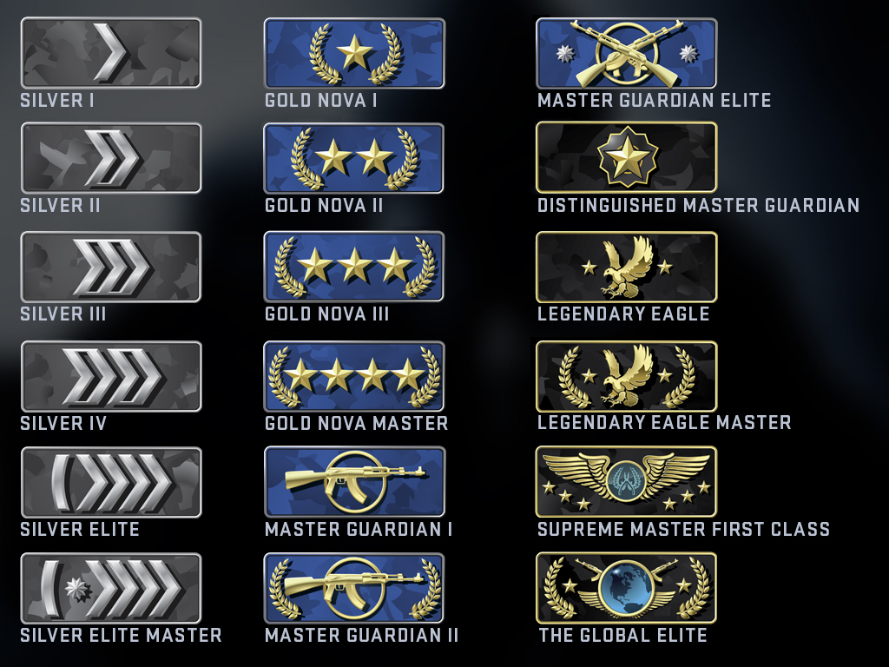
CSGO

Slide 6
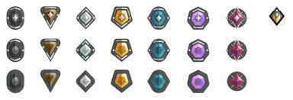
Valorant

Slide 7
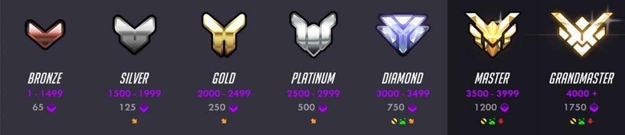
Overwatch (or any Blizzard Game)

Slide 8
Rank Distribution
Rank is the distribution of players across all the rank categories in a game.
It typically looks like a “bell curve”
It shows only from the worst players to the best players

Slide 9
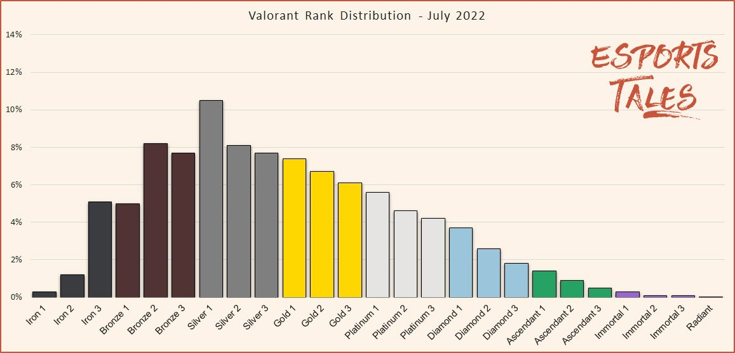
Valorant Rank Distribution

Slide 10
Skill Spread
Indicates the range of possible skill one could obtain
From literally incapable of playing to godlike
It is mathematically possible to have a 300% kills per shot ratio in CSGO, even though it’s highly improbable
“It’s possible but highly improbable because it requires skill that is nearly humanly unobtainable” – High Skill Ceiling
“It is not possible because the game will not allow you to do it, no matter how good you are” – Low Skill Ceiling

Slide 11
Mr. Smith, what does this have to do with my career?
Covid has destroyed our workforce
The Skill ceiling on skilled labor is very high
The Skill gap between “competent employee” and “average employee” is extreme
If you act now, you could spend the rest of your life smurfing your career, and absolutely CRUSHING anybody you compete for a job with

Slide 12
Try to buy a Playstation 5 at WalMart right now.
You can’t. They aren’t in stock
You have to custom order them and wait for them to be delivered to your local store
They cost $800!
A Playstation 4 was only $200 before the 5 came out
Why are they four times the price and you can’t even get them in stock?!

Slide 13
Nobody wants to work
There are problems with inflation and chip shortages, for sure.
Logistics companies cannot hire enough people to ship the Playstations.
There are thousands in warehouses in California, but nobody wants to do the work of moving them
Wal*Mart has to pay one person the wages of two to put them on the shelves
Because nobody wants to work, they have to offer more money
Wal*Mart employees do half the work as pre-covid empoyees
What are you gonna do? Fire them? You can’t replace them

Slide 14
Do the math
1 hour of unskilled labor costs:
Twice the money per hour
Twice the hours per employee
1 x 2 x 2 = 4 times the cost
Human Resources costs the average company 30% of their gross income.
That means $200 of that Playstation 4 costs $60 to pay all the people it took to build it and ship it and sell it
Today, post-covid, it would cost $240 to pay the employees to sell one Playstation 4

Slide 15
This is JUST Unskilled Labor (burger flippers)
Nobody wants to work
Unemployment recipients can extend their benefits just by scheduling interviews (they don’t have to go to them)
Employees do not attend their jobs, and cheat their employers every chance they get
Employers are forced to take anyone who will appear at an interview
My little brother had an interview this weekend. The only question they asked him was “Will you show up to work?”

Slide 16
Skilled Labor Does Not Exist
Why go to college, take on $70,000 of debt, spend four years of your life, get a degree, and make $20 an hour if you can just work at Rutter’s for $17 with no skills.
And you can play on your cell phone all day, because they can’t afford to fire you

Slide 17
Anecdotes:
22 people applied for the Maintenance position here
My father works for Michelin

Slide 18
This is unsustainable
The economy is GOING to collapse unless WE do something
Think of all your favorite things to consume.
They won’t exist anymore. No amount of money is enough to pay content creators or game developers if they can’t afford food, because nobody is making the food.
There will be nothing to look at on your cell phone at work
You will not be able to afford anything.
Things are too expensive because it costs too much to have people make them
People continue to hold out for better wages because things are too expensive
Things are too expensive because people are holding out for better wages for less work

Slide 19
Americans
Are suffering from being the most spoiled, entitled country on the planet
We all believe our school owe us gaming computers, are parents owe us smart phones, our employers owe us more money just for existing, and our government owe us a living, all for the meer fact that we are alive
If we don’t get these things, we believe we are being “oppressed”
Everybody thinks they are owed bread, but nobody wants to make the bread.

Slide 20
The Good News
It has never been easier to increase the skill gap between yourself and the average worker.
Who would keep their job?
Someone who is on their phone all day getting paid $20 an hour?
You, never on your phone, doing twice the work (easily) for the same price
I will now draw pictures about competitive ranks…

Slide 21
How to cheat your rank: A Good Team
Communicate, organize, and distribute the work
How many times have you been shot in the back in a Solo Queue because the random teammate you played with doesn’t have a mic and didn’t call out the enemy position?
Remove toxic players from your team
If your teammate makes you dislike the work, or distracts you from working, do not associate with them.

Slide 22
How to cheat your rank: A Captain
Every plan, good or bad, will fail 100% of the time if the team does not stick to it.
How many times have you called “Rush B”, only to die with one teammate while the other three are on the other side of the map?
The Captain is responsible for making all the decisions
You are only responsible for carrying them out
If the plan was executed to order, and it fails, it’s on the captain, not you
If the plan fails because you did not follow the orders, it’s on you, not the captain
You can give the Captain feedback, or find a new Captain, but during that game you must always follow the Captain

Slide 23
How did my rank change when I did this?
In CSGO I was Silver 4 (bottom 20% of players), in spite of a decade of playing Counter-Strike
I found team mates who were similar rank
I became the captain
We removed toxic players until we had a core five
In three months, with 0 statistical improvement to our skills, we were Master Guardian
In a year, we were Legendary Eagle (top 10% of all players in the world)

Slide 24
The Winning Attitude
Eliminate Toxicity
Bitching about it does literally nothing but ruin your morale
Morale is a resource in games, and in real life
Do not complain about the game, the Captain, the team or the opponents.
You have zero control over those aspects. Focusing on them is just toxic to your ability to improve
Instead, focus on what you could have done better
The science says people who are introspective about their failures improve orders of magnitudes greater than those who are not
In other words, you learn more from the games you lose than the games you win

Slide 25
Mr. Smith, you’re not talking about careers again
Did you know I only have an associate’s degree?
I took all these things I learned from CSGO and applied them to my life.
I could have just gotten an associate’s degree for $36,000 like all my other classmates
But I didn’t. I “knocked it out of the park” every day I went to school:
Perfect Attendance
Perfect 4.0 GPA
Student Body Government

Slide 26
My Skilled Labor Rank
I was performing at a Platinum level when everyone around me was performing at a Silver level.
I got the job. I got the office. I got the raise.
All your academic teachers have 6 year degrees and certifications, and I am making as much money as them, because I have proven I can work hard

Slide 27
Your Skilled Labor Rank
Ashton Sisson graduated from this school and took one year of college before being asked by an employer to drop out and start working for them for $25 an hour as a Junior developer.
All he has to do is keep working for a few years and they will pay him $50 an hours as a Senior Engineer
You are in the unique position where doing you best in this school, and doing well in college (if you so choose) puts you so far ahead of the rest of the entire labor industry that there is no comparison
In other words, becoming the Global Elite, the Grand Master, the Radiant ranked laborer has never been laughably easy.

Slide 28
America is on the verge of a reckoning
Eventually, we will have to face the stark reality that SOMEBODY has to make the bread, or we will all starve. The inflation will balance out.
By that time, job competition will be so fierce that only the absolute best in the world can and will be selected for the job.
There simply will not be enough money to go around.
After that, anyone who hasn’t already proven themselves will be unable to find any job they want (burger flipping will be cheap again)
You could spend every day of the rest of your life being bonkers rich or dirt poor. Those are the only two options.

Slide 29
One Last Anecdote
My buddy Hunter works in concrete…
I only want the top-ranking students in my class
If you do not want be the best, tell your guidance counselor you want to go back to your sending school.
We do not need toxic teammates holding us back.

Slide 30
You could be Smurfing IRL
Literally all you have to do is
Do Your Best, Every Day

